Slide 1
Save the Date: International Kv7 Channels Symposium 2019
WWW.Kv7CHANNELS2019NAPLES.ORG
12-14 September 2019 - Naples, Italy

Slide 2
GENERAL INFORMATION
Programme topics
• Physiological function
• Role in diseases
• Assembly properties
• Regulatory mechanisms
• Auxiliary proteins
• Pharmacological aspects
• Therapeutic targeting
• Tools and models
Important dates
1 November 2018: Abstract submission and registration opens
22 April 2019: Abstract deadline
15 June 2019: Early registration
Venue
Via Partenope, Aula Magna, University of Naples Frederico II, Naples, Italy
WWW.Kv7CHANNELS2019NAPLES.ORG

Slide 3
COMMITTEES
Scientific Committee
Iain Greenwood, Institute of Molecular & Clinical Sciences, St George’s, University of London, UK (Symposium Chair)
Maurizio Taglialatela, Department of Neuroscience, University of Naples Federico II, IT (Symposium Chair)
Mark S. Shapiro, Department of Cellular and Integrative Physiology, University of Texas Health Science Center, San Antonio, US
Geoffrey Abbott, Department of Physiology and Biophysics, UC Irvine, US
Nikita Gamper, Faculty of Biological Sciences, University of Leeds, UK
Hailin Zhang, Department of Pharmacology, The Key Laboratory of Neural and Vascular Biology, Ministry of Education, Hebei Medical University, Shijiazhuang, CHN
Local Organising Committee
Francesco Miceli, Department of Neuroscience, University of Naples Federico II, IT
Maria Virginia Soldovieri, Department of Health Sciences, University of Molise, Campobasso, IT
Vincenzo Barrese, Institute of Molecular & Clinical Sciences, St George’s, University of London, UK
Thomas Jepps, Department of Biomedical Sciences, University of Copenhagen, DK
WWW.Kv7CHANNELS2019NAPLES.ORG

Slide 4
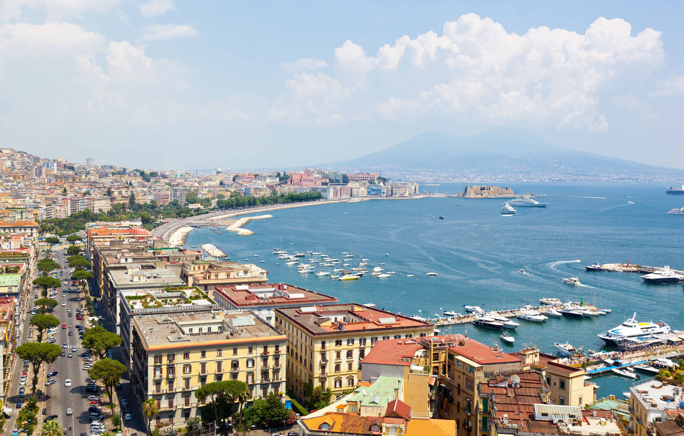
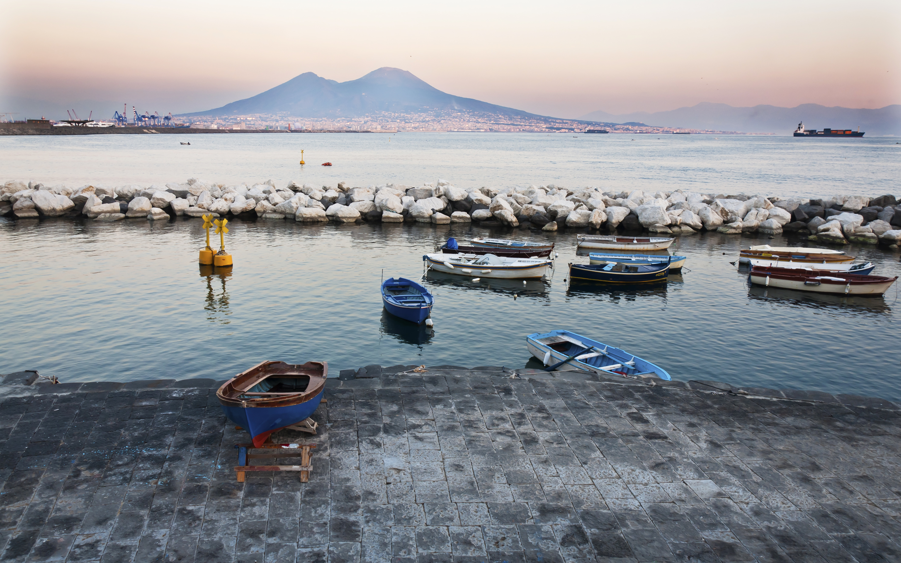
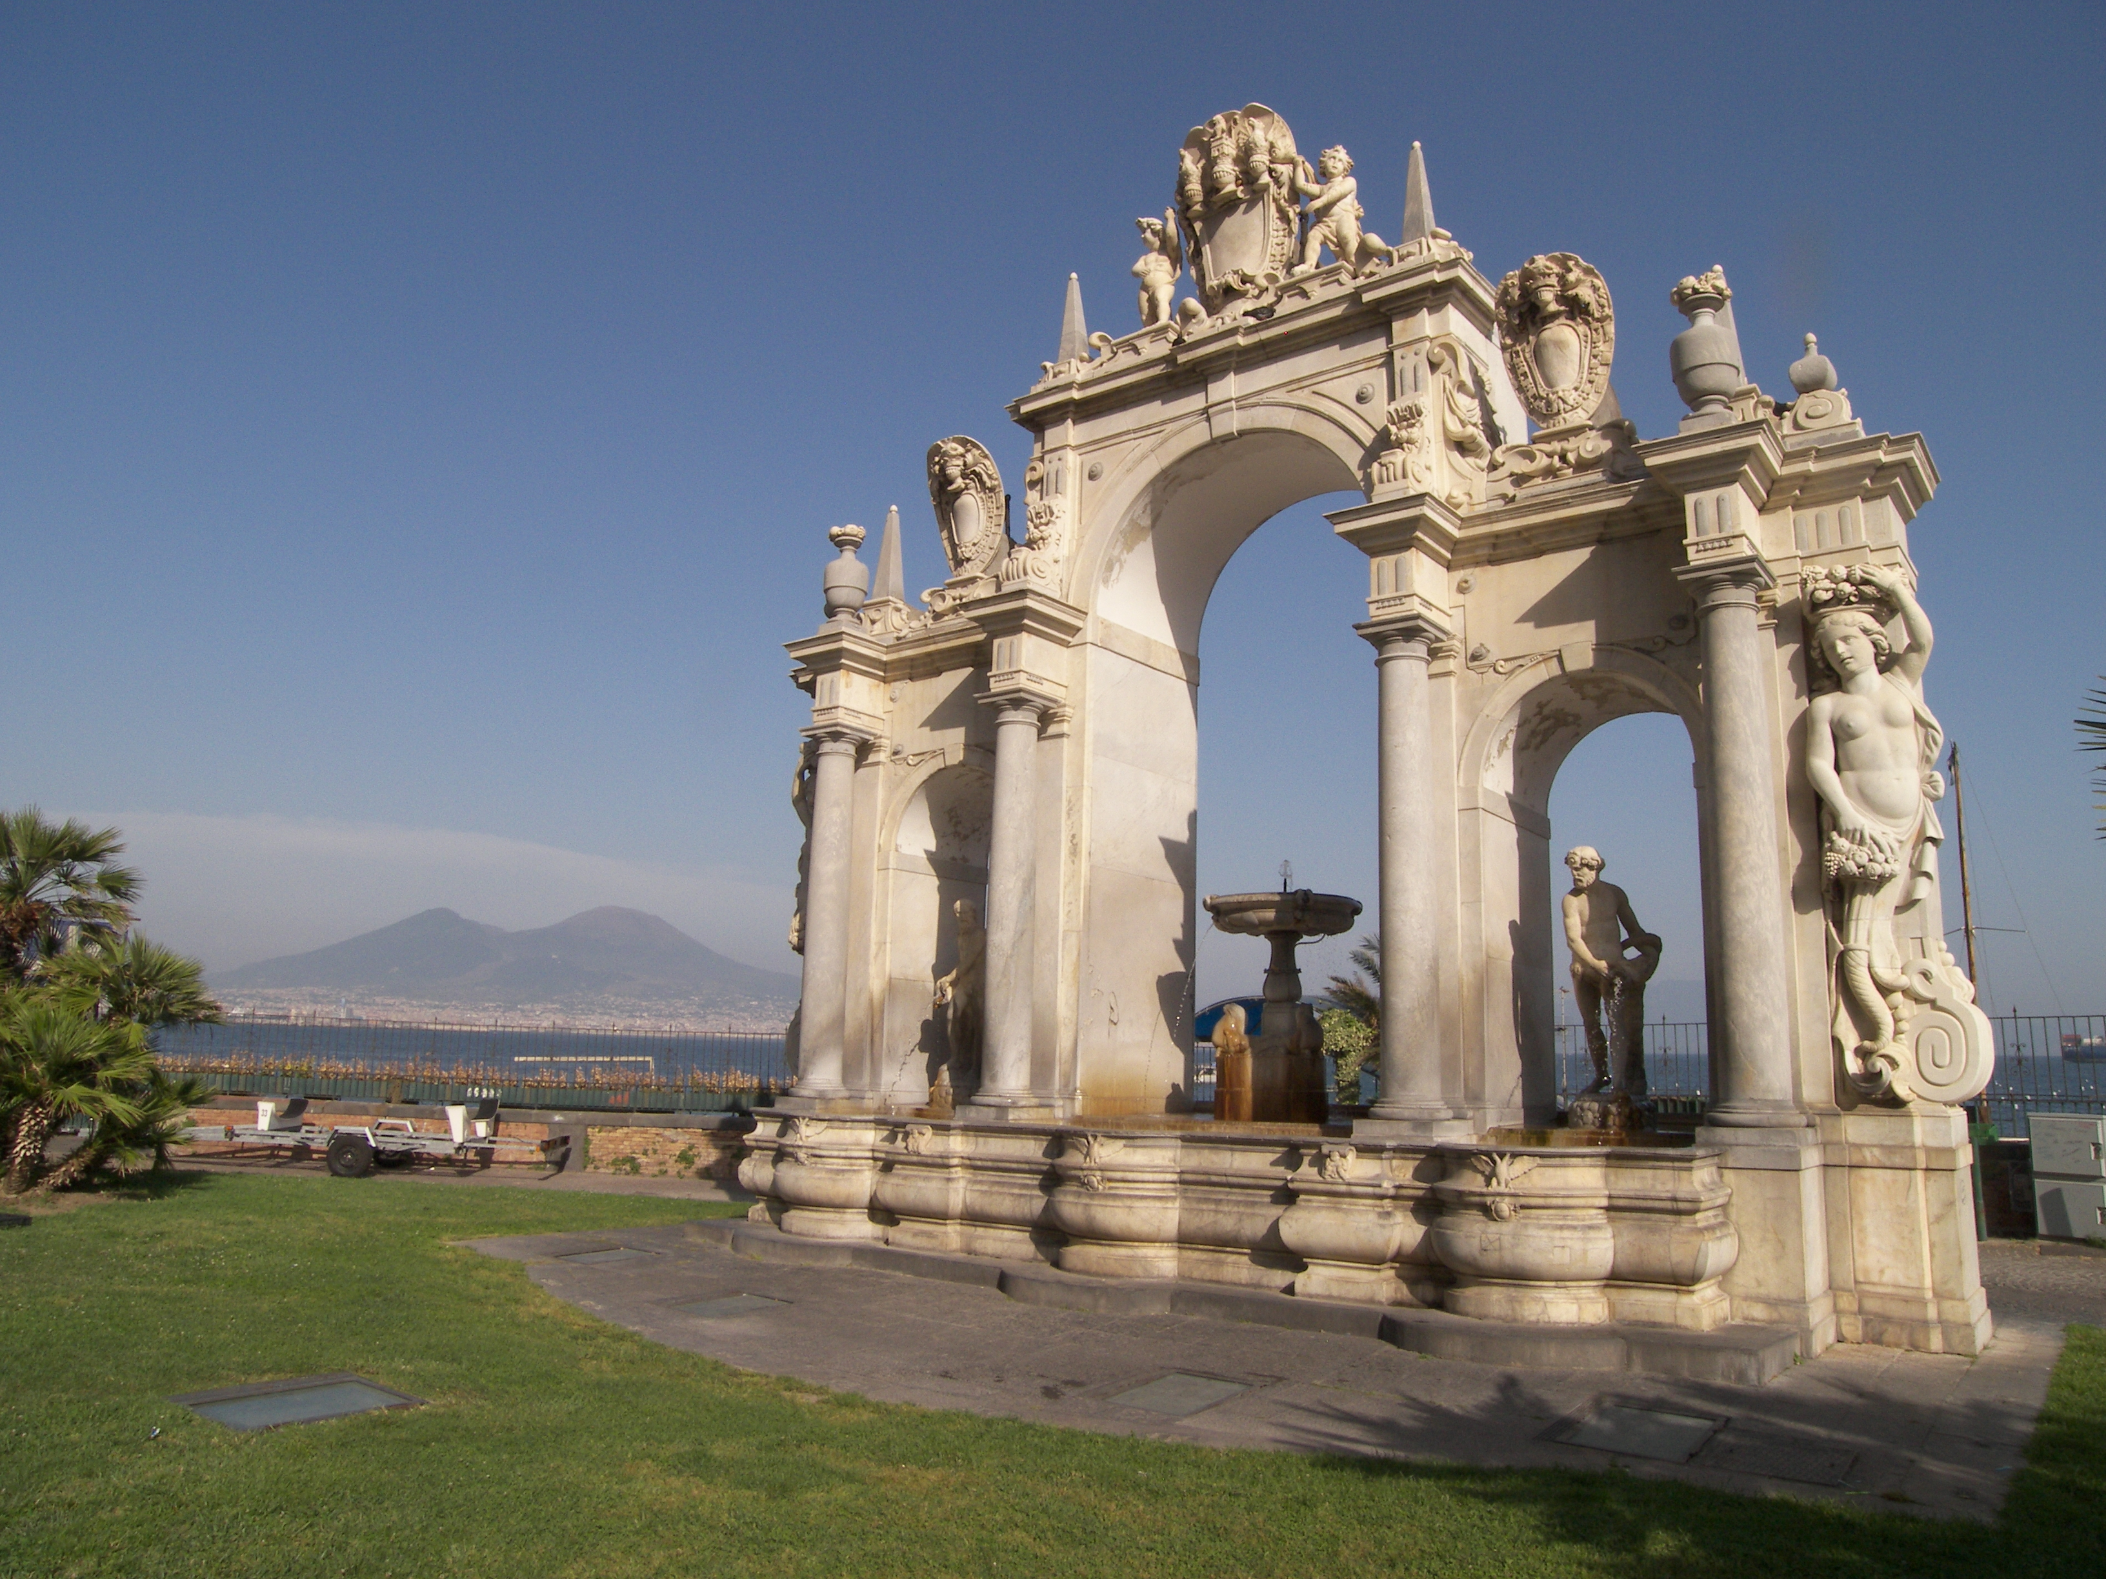
We hope to see you in Naples!

